Slide 1
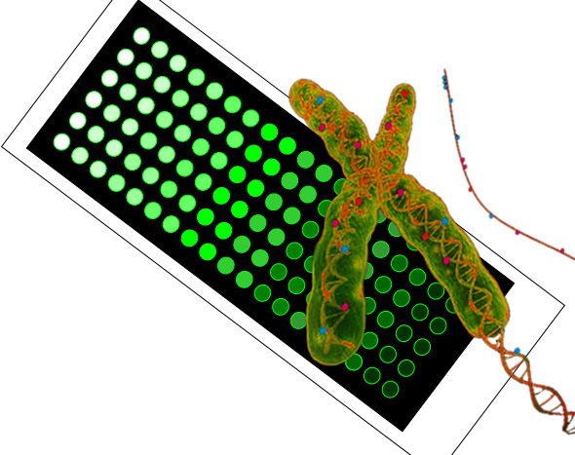
Rapid quantification of 5mC and 5hmC on multi-sample array slides
Sigal Avraham
Under the supervision of
Prof. Yuval Ebenstein
CBRC 3rd virtual seminar
November 2020
1/14

Slide 2
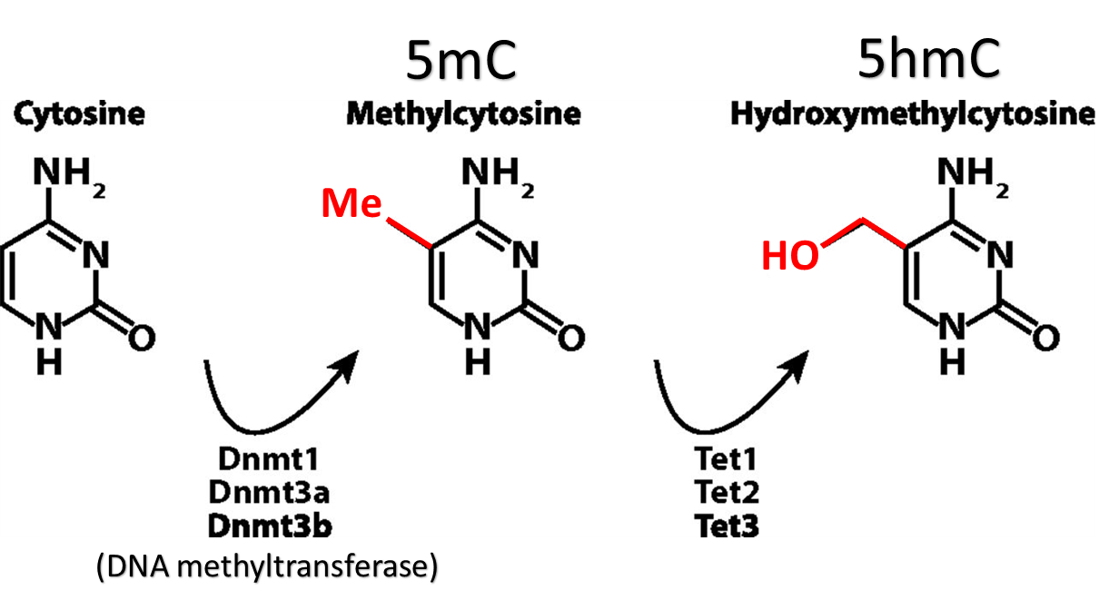
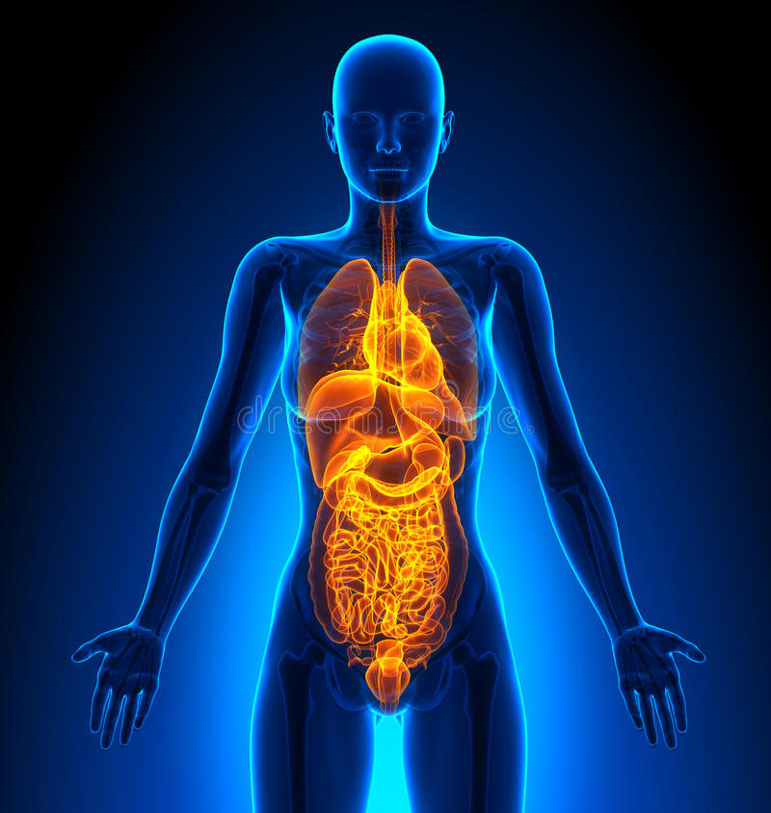
Epigenetic modifications
Brain
Heart
lungs
Stomach
Liver
Intestines
CpG = CG sequence
Epigenetic modification
2/14
(DNA methyltransferase)

Slide 3
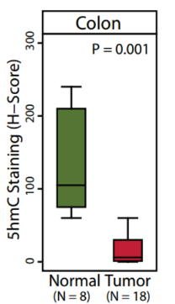
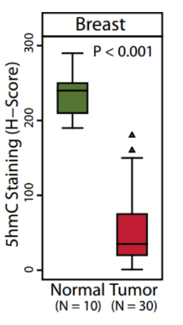
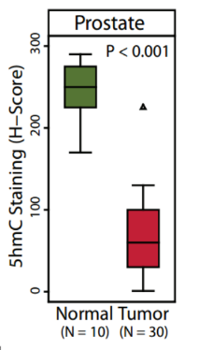
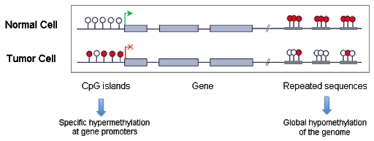
5mC & 5hmC in cancer
Global 5mC decrease &
increase in cancer
Global 5hmC decrease in cancer
Haffner et al., Oncotarget, 2011
3/14

Slide 4
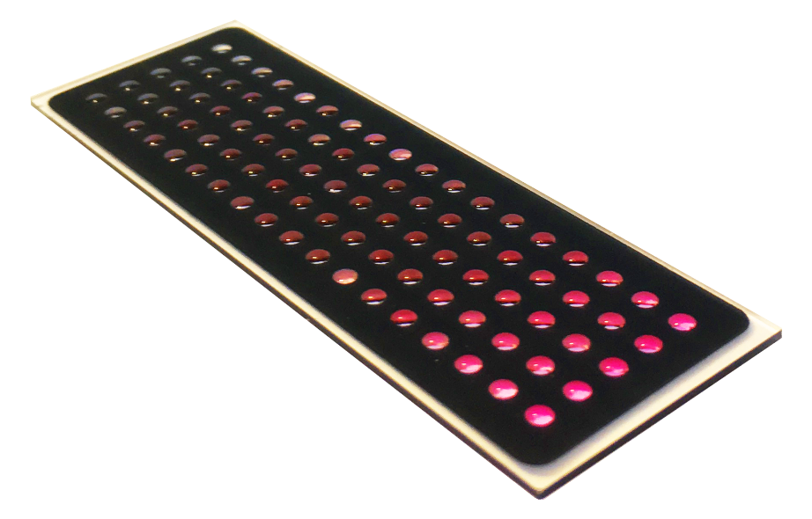
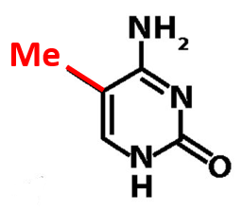
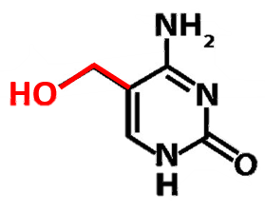
Motivation
Global epigenetics analysis can serve in:
Early detection
Disease progression
Response to treatment
→ 5mC & 5hmC can serve as biomarkers for cancer!
In combination with our assay:
High sensitivity
High-throughput
Multi-sample analysis
Clinical cancer diagnostics
5mC
5hmC
4/14

Slide 5
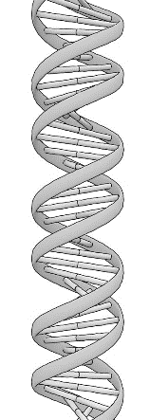
Fluorescent labeling of 5mC and 5hmC
High intensity ↑ = Low 5mC ↓
DNA Methyltransferase enzyme:
Mmpel (dm)
Fluorophore
Fluorophore
$$N_{3}$$
$$N_{3}$$
5’-CG-3’
AdoYnN3
Click chemistry
Un-methylated CpG site
High intensity ↑ = High 5hmC ↑
Fluorophore
Fluorophore
5hmC
5hmC
$$N_{3}$$
$$N_{3}$$
T4-βGT
UDP-6-N₃-Glu
Click chemistry
5/14

Slide 6
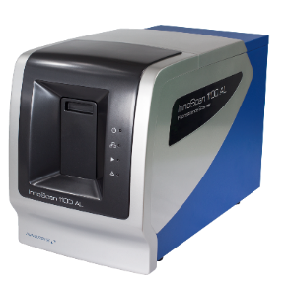
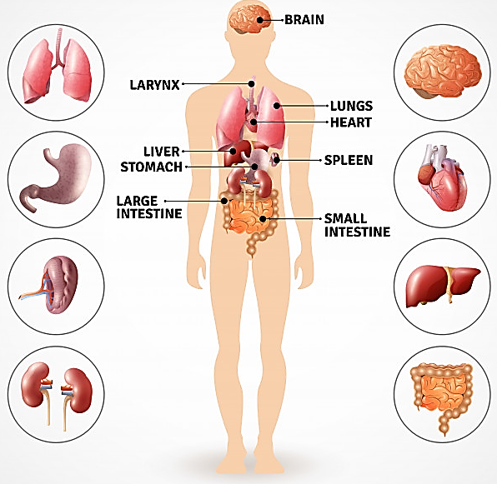
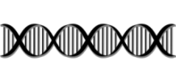
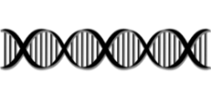
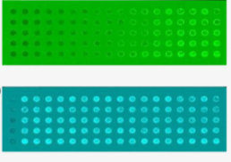
Workflow
=5hmC/5mC
%labeled 5hmC
Water 0% 0.0035%
0.1161%
TAMRA (green):
labeled 5-hmC samples
EvaGreen (blue):
total DNA stain
Margalit, Avraham et al. Int. J. Cancer (2019)
6/14

Slide 7
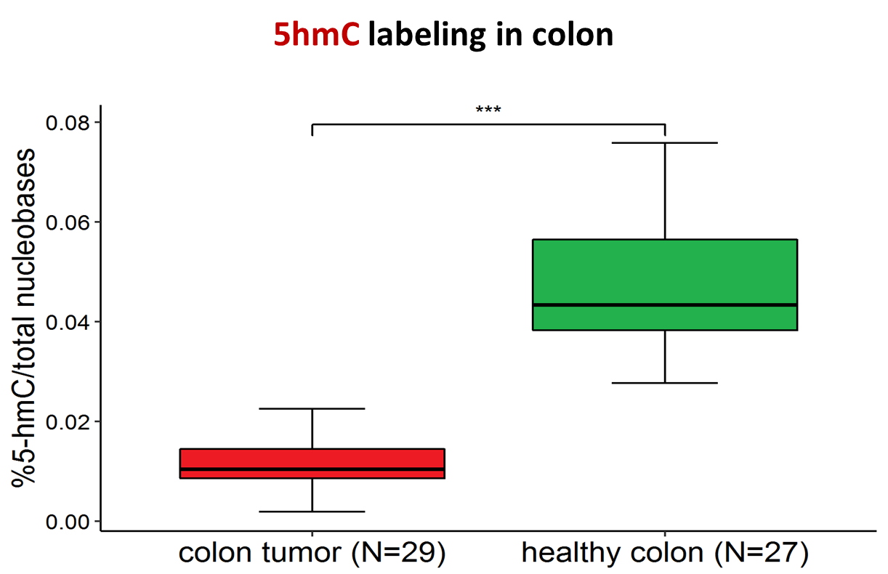
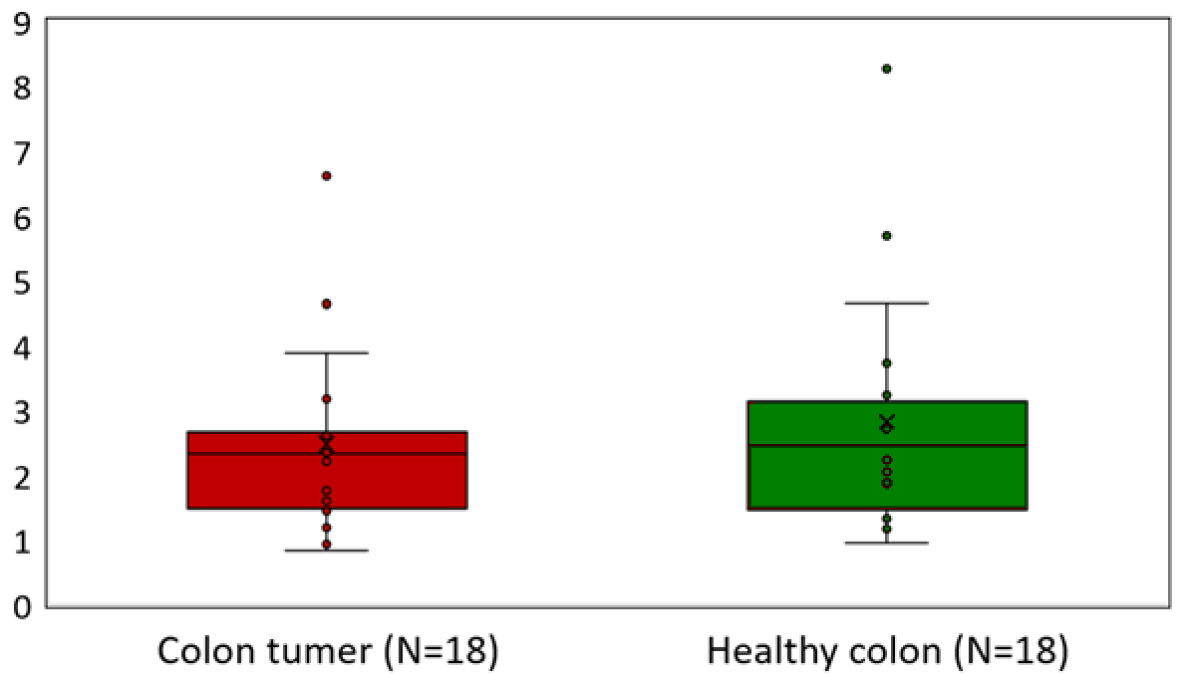
Results: 5hmC and 5mC in Colorectal cancer
5mC in colon
1/Relative intensity
Colon tumor (N=18) healthy colon (N=18)
Decrease in 5hmC levels
No global change in 5mC
Margalit, Avraham et al. Int. J. Cancer (2019)
7/14

Slide 8
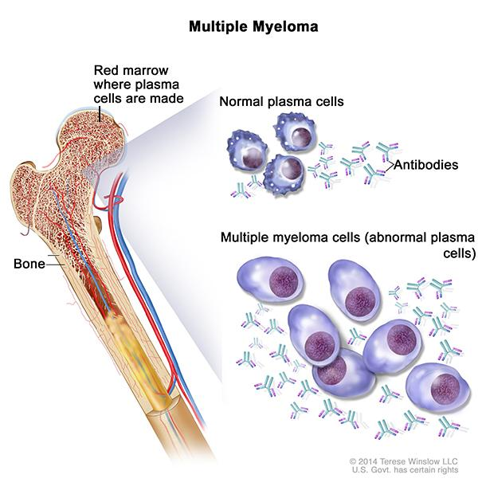
Monoclonal Gammopathy of Undetermined Significance (MGUS)
Multiple Myeloma cancer
MGUS
Monoclonal Gammopathy of Undetermined Significance
8/14

Slide 9
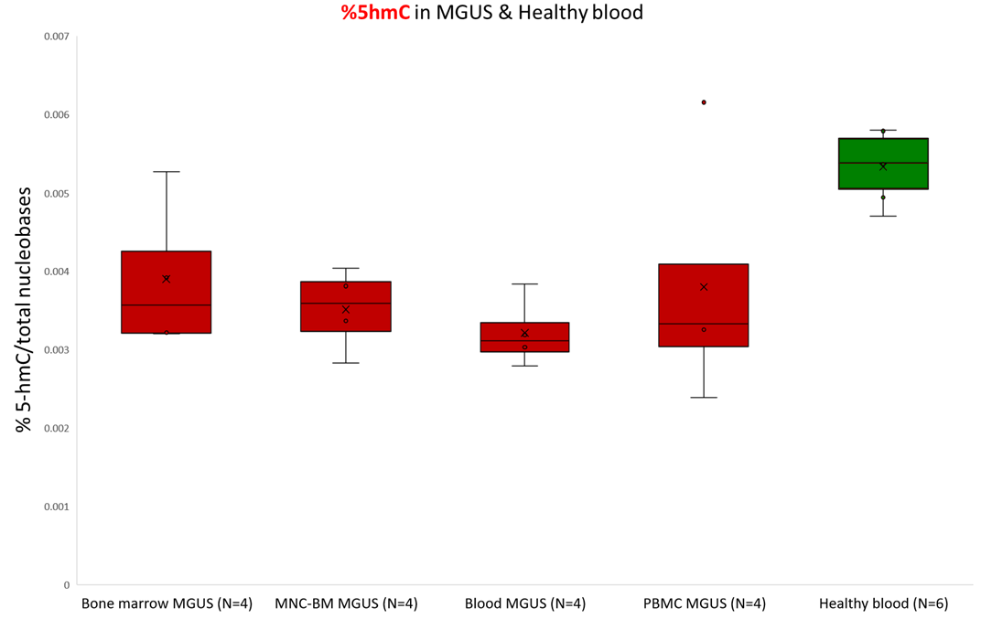
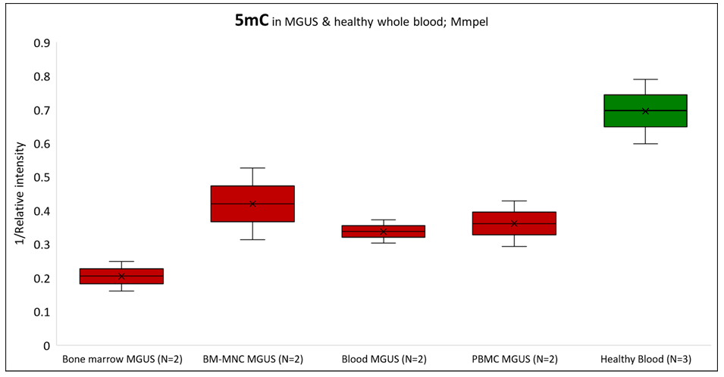
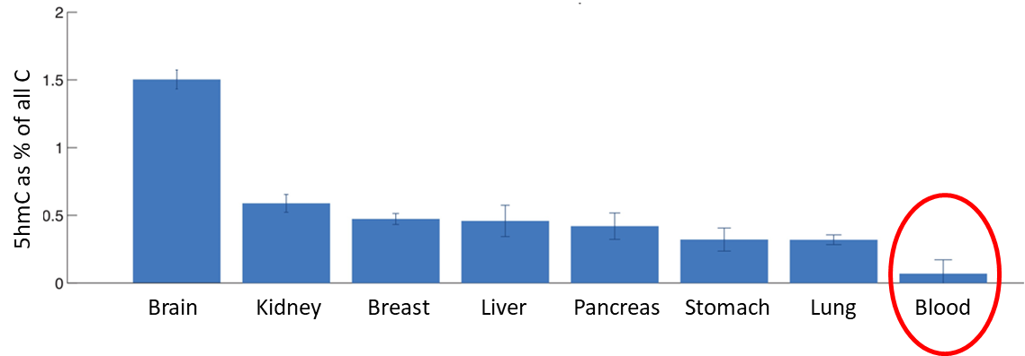
Results: 5hmC and 5mC in MGUS
%5hmC in MGUS &Healthy blood
5hmC in MGUS &Healthy blood
5mC in MGUS &Healthy blood
1/Relative intensity
Bone marrow (N=4)
BM-MNC (N=4)
Blood
(N=4)
PBMC
(N=4)
Healthy blood
(N=6)
Bone marrow (N=2)
BM-MNC (N=2)
Blood
(N=2)
PBMC
(N=2)
Healthy blood
(N=3)
Decrease in 5hmC levels
Decrease in 5mC levels
Tomkova et al. eLife 2016
9/14

Slide 10
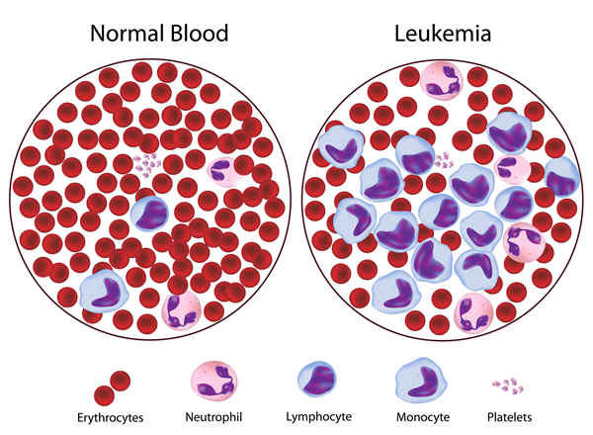
Chronic lymphocytic Leukemia (CLL)
1
2
3
4
5
Dual color labeling
Single molecule images; Till fluorescent microscope
10/14

Slide 11
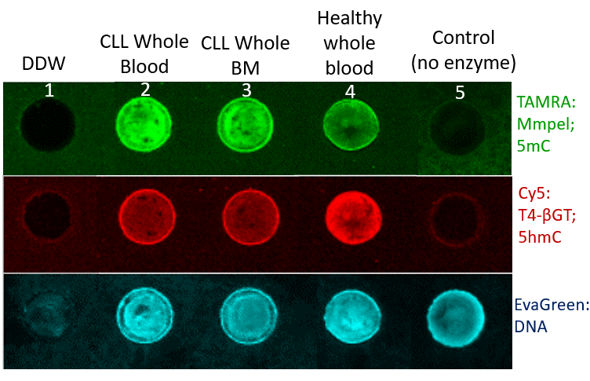
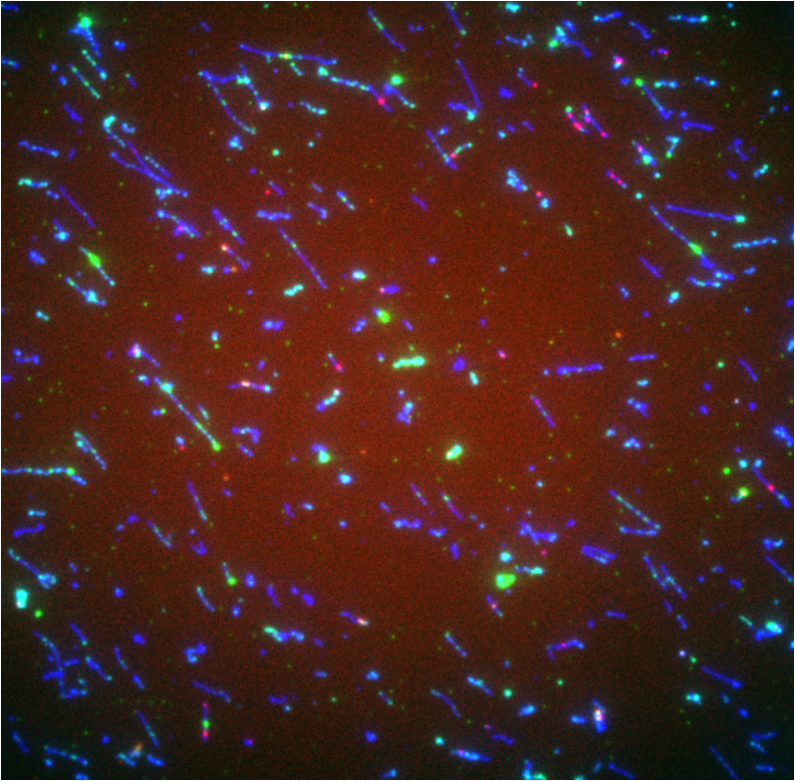
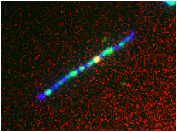
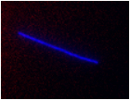
Dual color labeling in CLL 5hmC → 5mC
5hmC
High intensity ↑ = Low 5mC ↓
CG
CG
CG
CG
High intensity ↑ = High 5hmC ↑
4um
CLL
1
2
3
4
5
Healthy
control
Single molecule images; Till fluorescent microscope
11/14

Slide 12
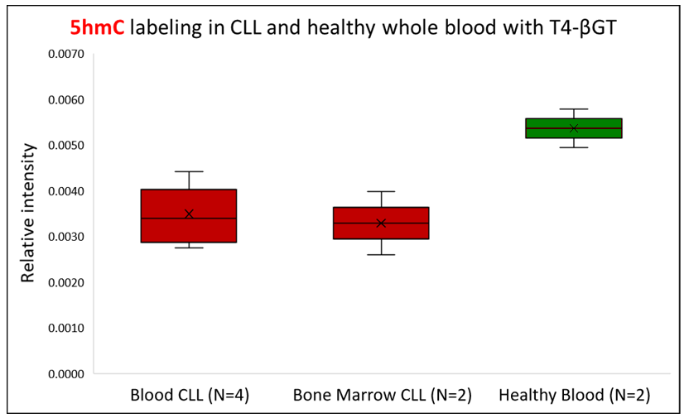
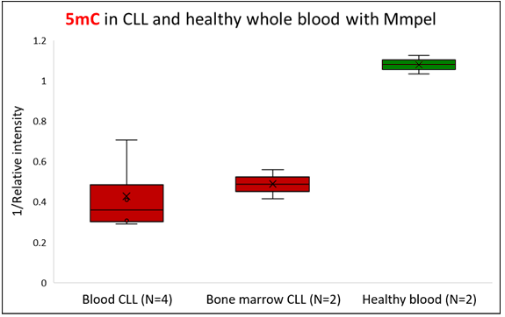
Results: 5hmC and 5mC in CLL
5hmC
5mC
→ Decrease in 5mC & 5hmC levels
12/14

Slide 13
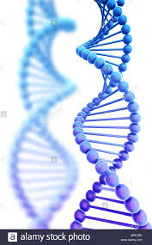
Summary
Rapid and sensitive assay for global 5mC and 5hmC detection.
5mC and 5hmC as biomarkers for cancer.
Cancer diagnostics from a simple blood test.
Potential Multiplexing - Integration with other epigenetic modifications and DNA damage lesions.
13/14

Slide 14
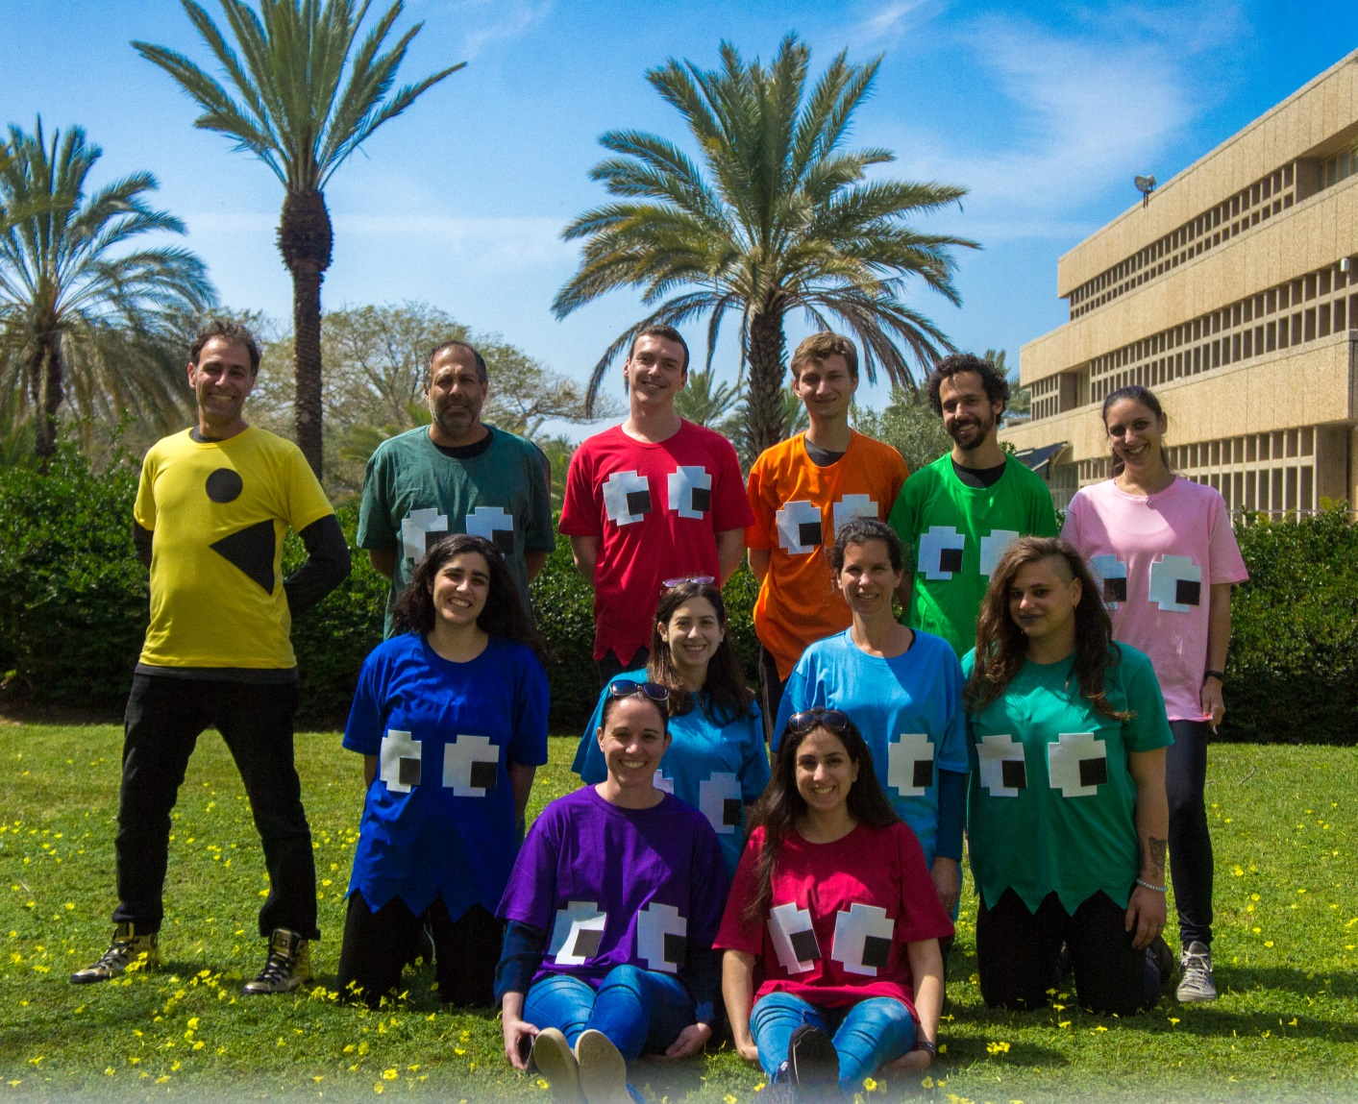
NanoBioPhotonixLab
Prof. Yuval Ebenstein
Dr. Shahar Zirkin
Dr. Yael Michaeli
Dr. Tamar Shahal
Dr. Zuzka Tulpova
Dmitry Torchinski
Jonathan Jeffet
Gil Nifker
Noa Gilat
Sapir Margalit
Sivan Fishman
Dena Fridman
Adaya Ben-Moshe
Gal Goldner
Collaborators:
Prof. Elmar Weinhold
Dr. Relly Forer, DYN diagnostics
Dr. Maya Koren-Michowitz
Dr. Roni Golan-Lavi
Thank You!
14/14

